Slide 1
AI Search Algorithms

Slide 2
Introduction to Search in AI
Search is fundamental to problem-solving in AI.
Many AI problems can be modeled as search problems.
Examples: Finding a route on a map, Solving puzzles, Game playing

Slide 3
Components of a Search Problem
Initial State
Goal State
State Space
Successor Function
Path Cost

Slide 4
1. Initial State
Definition: The starting point or configuration of the problem before any actions have been taken.
Example: In a puzzle game like the 8-puzzle, the initial state is the starting arrangement of the tiles.
Purpose: Represents where the search begins.
2. Goal State
Definition: The desired final state or configuration that the search aims to reach.
Example: In the 8-puzzle, the goal state is the arrangement where the tiles are in the correct order.
Purpose: Defines the condition(s) that must be satisfied to consider the problem solved.
State Space
Definition: The set of all possible states or configurations that can be reached from the initial state by applying actions.
Example: For the 8-puzzle, the state space includes every possible arrangement of the tiles.
Purpose: Represents the entire search domain, where the search algorithm explores to find a path from the initial to the goal state.
4. Successor Function
Definition: A function that takes a state as input and returns a set of successor states reachable from the current state by applying possible actions.
Example: In a chess game, the successor function generates all legal moves from a given board position.
Purpose: Defines how the search moves from one state to another and enables the exploration of the state space.
5. Path Cost
Definition: A numeric value representing the cost of moving along a path from the initial state to a particular state.
Example: In a route-finding problem, path cost could be the total distance traveled or total travel time.
Purpose: Used to evaluate and compare different paths, helping the algorithm find the least costly or most efficient route to the goal.

Slide 5
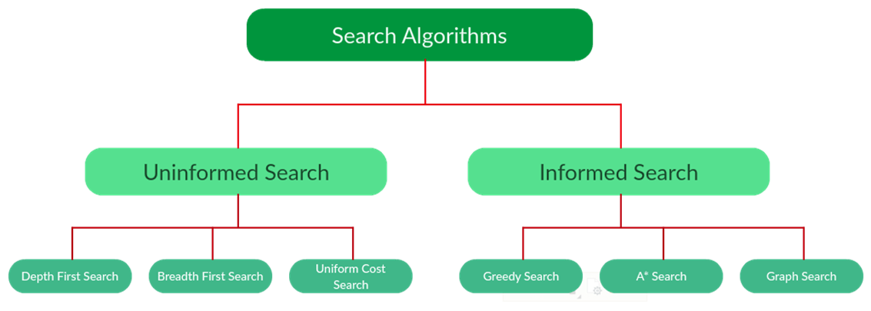

Slide 6
Types of Search Algorithms
Uninformed (Blind) Search - No domain-specific knowledge
Informed (Heuristic) Search - Uses domain knowledge to guide the search
• Search is fundamental in AI for decision-making and problem-solving.
• Uninformed search is systematic but inefficient.
• Informed search uses heuristics to improve efficiency.
• Choosing the right search algorithm depends on the problem constraints and available knowledge

Slide 7
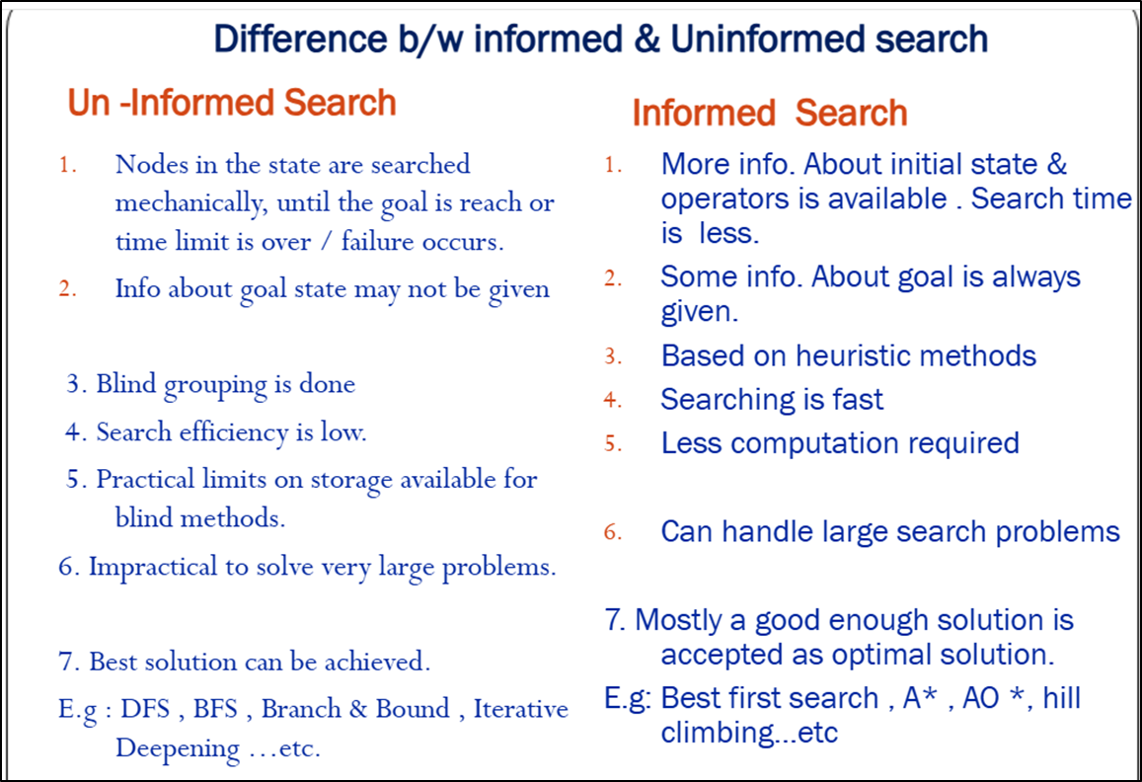

Slide 9
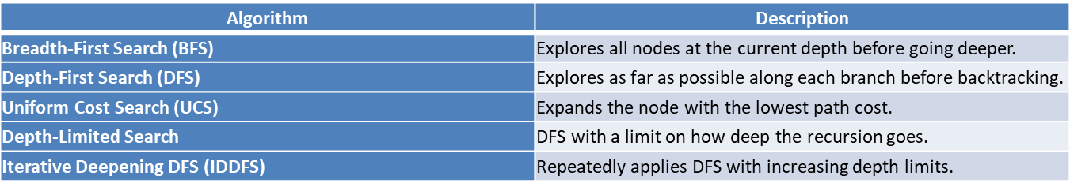
Uninformed (Blind) Search
• No additional information about the goal state is used.
• Only the problem definition is known.
Pros:
• Simple to implement.
• Systematic.
Cons:
• Often inefficient.
• Time and space complexity can be high.

Slide 10
Breadth-First Search (BFS)
Explores neighbors first before going deeper
Uses a queue (FIFO)
Completeness: Yes
Optimality: Yes (if cost = 1)
Time/Space: O(b^d)

Slide 11
Depth-First Search (DFS)
Explores as far as possible down one branch
Uses a stack (LIFO)
Completeness: No
Optimality: No
Time: O(b^m)
Space: O(bm)

Slide 12
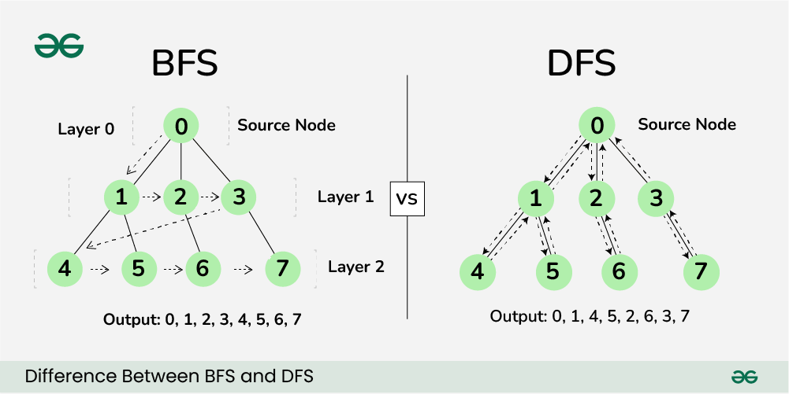
Difference between BFS and DFS
Breadth-First Search (BFS) and Depth-First Search (DFS) are two fundamental algorithms used for traversing or searching graphs and trees. This article covers the basic difference between Breadth-First Search and Depth-First Search.

Slide 13
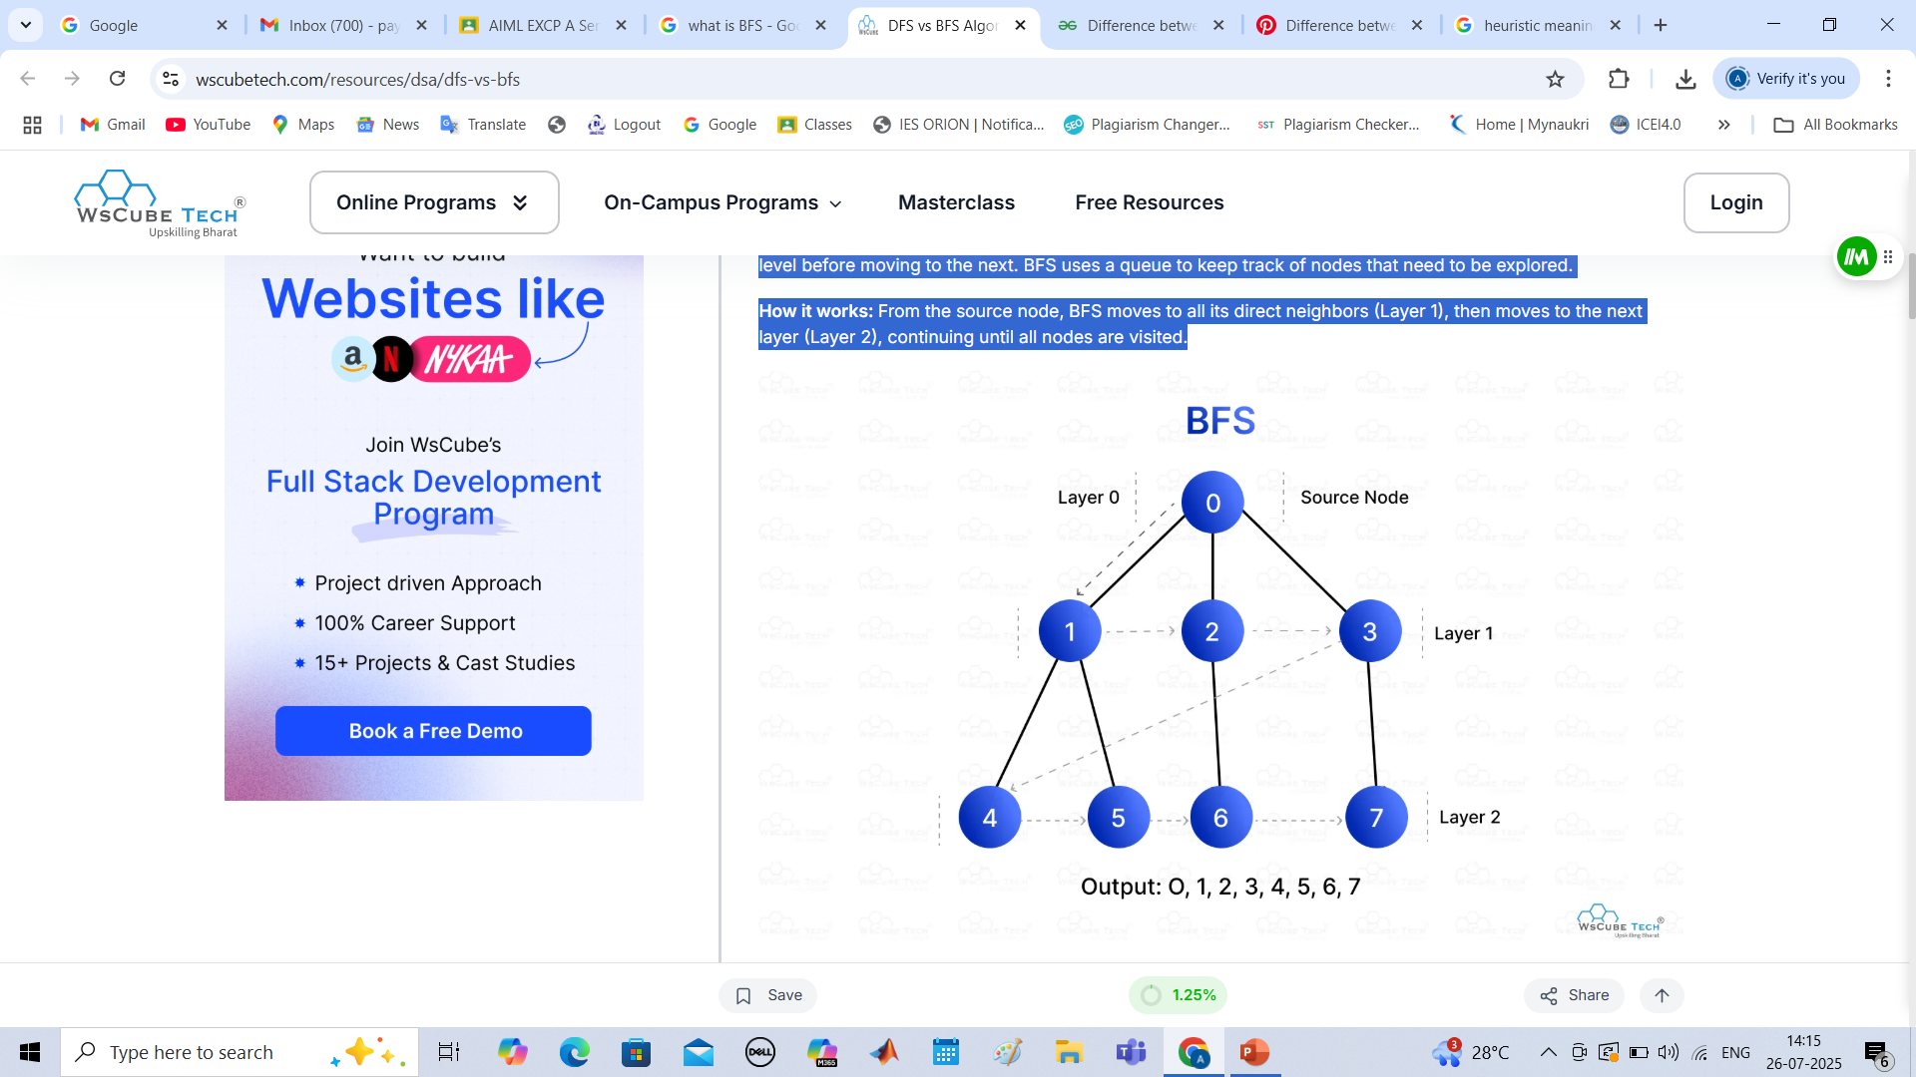
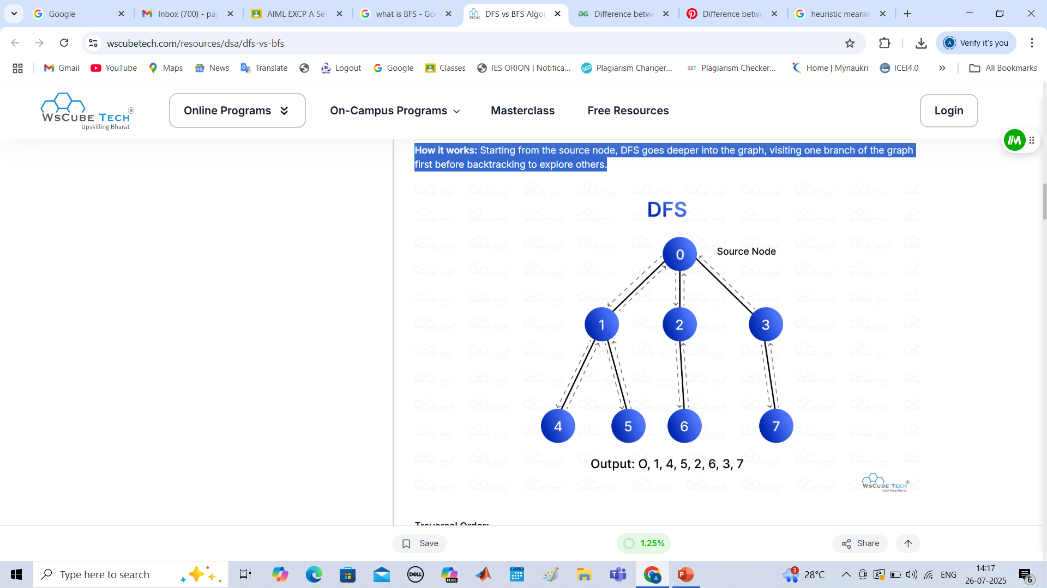
1. BFS
Approach: BFS explores the graph level by level, starting from the source node. It visits all the nodes at one level before moving to the next. BFS uses a queue to keep track of nodes that need to be explored.
How it works: From the source node, BFS moves to all its direct neighbors (Layer 1), then moves to the next layer (Layer 2), continuing until all nodes are visited.
Traversal Order:
Starting from node 0:
Layer 0: Visit node 0 (source node).
Layer 1: Visit nodes 1, 2, 3 (neighbors of node 0).
Layer 2: Visit nodes 4, 5, 6, 7 (neighbors of nodes 1, 2, 3).
Output: 0, 1, 2, 3, 4, 5, 6, 7.
2. DFS
Approach: DFS explores as deep as possible along a branch before backtracking. It uses a stack (or recursion) to keep track of nodes and backtracks when it reaches a dead end.
How it works: Starting from the source node, DFS goes deeper into the graph, visiting one branch of the graph first before backtracking to explore others.
Traversal Order:
Starting from node 0:
Visit node 0 → Visit node 1 → Visit node 4 (deepest) → Backtrack to node 1 → Visit node 5 → Backtrack to node 0 → Visit node 2 → Visit node 6 → Backtrack to node 2 → Visit node 3 → Visit node 7.
Output: 0, 1, 4, 5, 2, 6, 3, 7

Slide 14
Parameters | BFS | DFS
Stands for | BFS stands for Breadth First Search. | DFS stands for Depth First Search.
Data Structure | BFS(Breadth First Search) uses Queue data structure for finding the shortest path. | DFS(Depth First Search) uses Stack data structure.
Definition | BFS is a traversal approach in which we first walk through all nodes on the same level before moving on to the next level. | DFS is also a traversal approach in which the traverse begins at the root node and proceeds through the nodes as far as possible until we reach the node with no unvisited nearby nodes.
Conceptual Difference | BFS builds the tree level by level. | DFS builds the tree sub-tree by sub-tree.
Approach used | It works on the concept of FIFO (First In First Out). | It works on the concept of LIFO (Last In First Out).
Suitable for | BFS is more suitable for searching vertices closer to the given source. | DFS is more suitable when there are solutions away from source.
Applications | BFS is used in various applications such as bipartite graphs, shortest paths, etc. If weight of every edge is same, then BFS gives shortest path from source to every other vertex. | DFS is used in various applications such as acyclic graphs and finding strongly connected components etc. There are many applications where both BFS and DFS can be used like Topological Sorting, Cycle Detection, etc.

Slide 15
When to Use: DFS vs BFS?
When to Use DFS:
Exploring All Paths: DFS is useful when you need to explore all possible paths, such as in maze solving or finding connected components in a graph.
Backtracking Problems: DFS is great for problems that involve backtracking, like solving puzzles, detecting cycles, or performing topological sorting in a graph.
Memory Efficiency in Deep Graphs: DFS uses less memory on deep but narrow graphs, as it only needs to store a single branch at a time.
Tree Traversal: DFS is used for pre-order, in-order, and post-order traversal of trees.
When to Use BFS:
Shortest Path in Unweighted Graphs: BFS is ideal for finding the shortest path in unweighted graphs because it explores all nodes at the current level before moving deeper.
Level-Order Traversal: BFS is perfect for level-order traversal of trees or graphs, visiting all nodes at the same depth.
Shallow/Wide Graphs: BFS works well on shallow but wide graphs, as it explores level by level and efficiently handles many nodes at a given depth.
Minimum Moves or Steps: Problems like finding the minimum number of moves (e.g., puzzles like Word Ladder) are better solved with BFS.

Slide 16
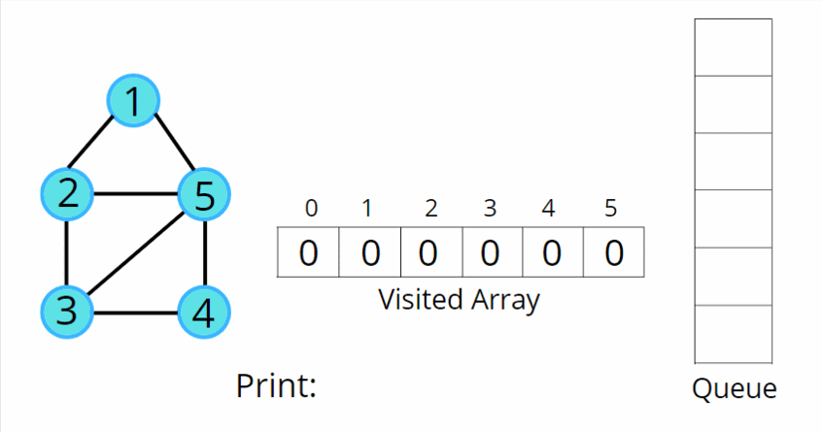
Problem Statement: Given an undirected graph, return a vector of all nodes by traversing the graph using breadth-first search (BFS).
Approach:
Initial Configuration:
Queue data structure: follows FIFO, and will always contain the starting.
Visited array: an array initialized to 0
In BFS, we start with a “starting” node, mark it as visited, and push it into the queue data structure.
In every iteration, we pop out the node ‘v’ and put it in the solution vector, as we are traversing this node.
All the unvisited adjacent nodes from ‘v’ are visited next and are pushed into the queue. The list of adjacent neighbors of the node can be accessed from the adjacency list.
Repeat steps 2 and 3 until the queue becomes empty, and this way you can easily traverse all the nodes in the graph.

Slide 17
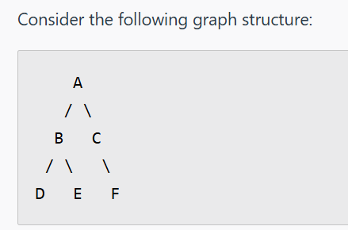
BFS explores the graph level by level, starting from a chosen root node (vertex A in this case). Here's how the traversal proceeds:
Initialization:
Enqueue the starting node A into a queue.
Mark A as visited to avoid revisiting it.
Exploration:
Step 1: Dequeue A from the queue (current node) and visit it. Then enqueue its neighbors B and C, and mark them as visited.
Step 2: Dequeue B and visit it. Then enqueue its neighbors D and E, marking them as visited.
Step 3: Dequeue C and visit it. Then enqueue its neighbor F, and mark F as visited.
Step 4: Dequeue D and visit it. Since D has no neighbors, move to the next node.
Step 5: Dequeue E and visit it. Similarly, E has no neighbors.
Step 6: Dequeue F and visit it. F has no neighbors.
Final BFS Traversal Order:
The nodes are visited in the following order: A -> B -> C -> D -> E -> F

Slide 18
from collections import deque def bfs(graph, start_vertex): visited = set() queue = deque([start_vertex]) visited.add(start_vertex) while queue: vertex = queue.popleft() print(vertex, end=" ") for neighbor in graph[vertex]: if neighbor not in visited: visited.add(neighbor) queue.append(neighbor) # Example graph represented as an adjacency list graph = { 'A': ['B', 'C'], 'B': ['D', 'E'], 'C': ['F'], 'D': [], 'E': [], 'F': [] } bfs(graph, 'A')
Python Code for BFS

Slide 19
Uniform Cost Search (UCS)
Expands the node with the lowest path cost
Uses a priority queue
Completeness & Optimality: Yes
Time/Space: O(b^C*/ε)

Slide 20
Comparison Table (Uninformed)
BFS - Complete: Yes, Optimal: Yes, Time: O(b^d), Space: O(b^d)
DFS - Complete: No, Optimal: No, Time: O(b^m), Space: O(bm)
UCS - Complete: Yes, Optimal: Yes, Time/Space: O(b^C*/ε)
• BFS expanding layer by layer
• DFS going deep
•

Slide 21
Breadth First Search
In Breadth First Search(BFS), the root node of the graph is expanded first, then all the successor nodes are expanded and then their successor and so on i.e. the nodes are expanded level wise starting at root level.
For Example :

Slide 22
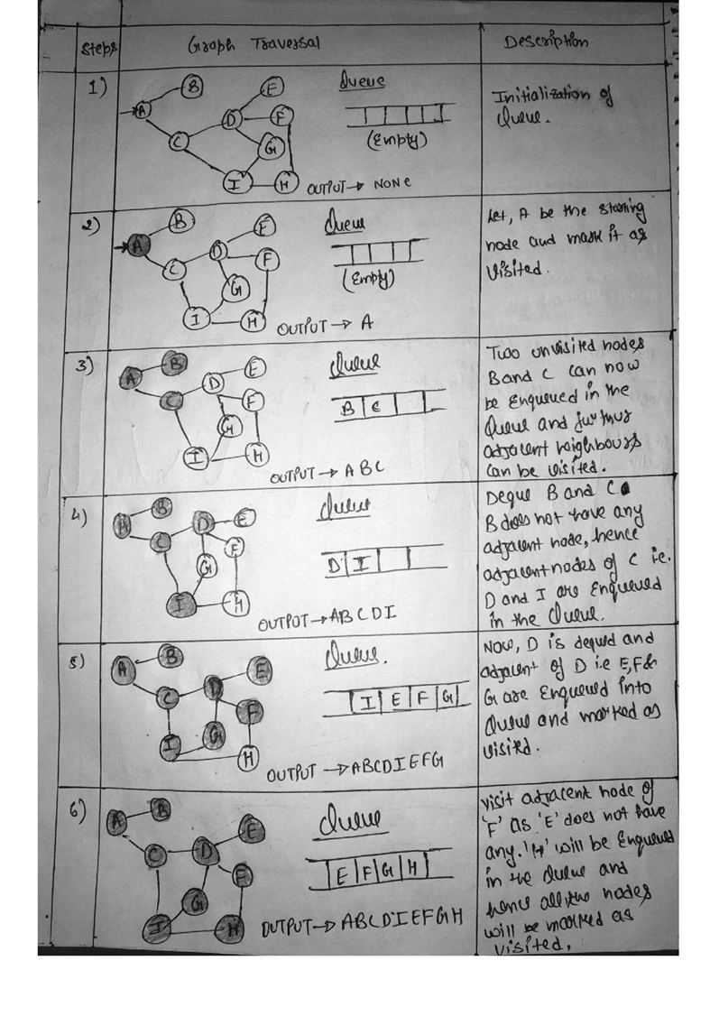

Slide 23
Depth First Search
In Depth First Search(DFS), the deepest node is expanded in the current unexplored node of the search tree. The search goes into depth until there is no more successor nodes.
For Example :

Slide 24
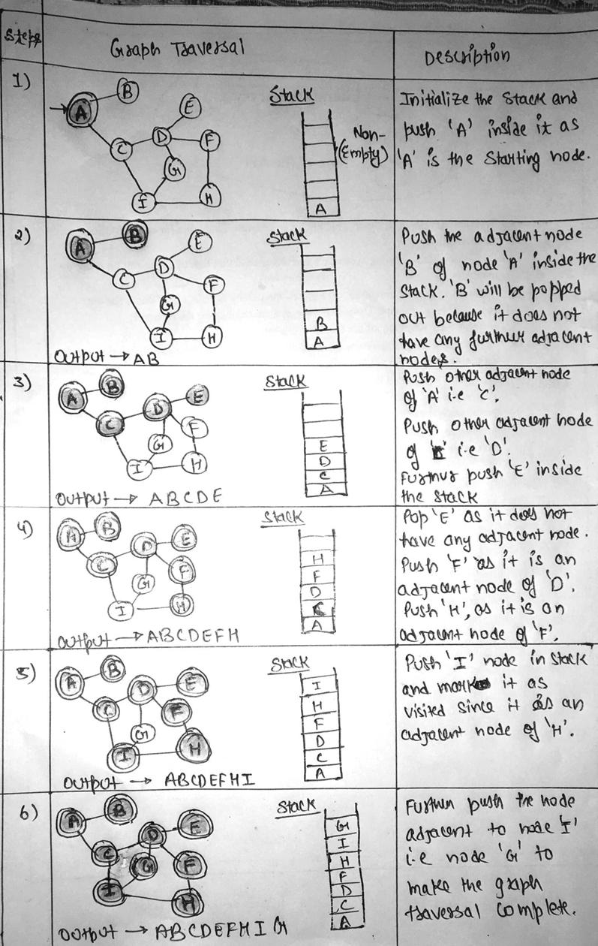

Slide 25
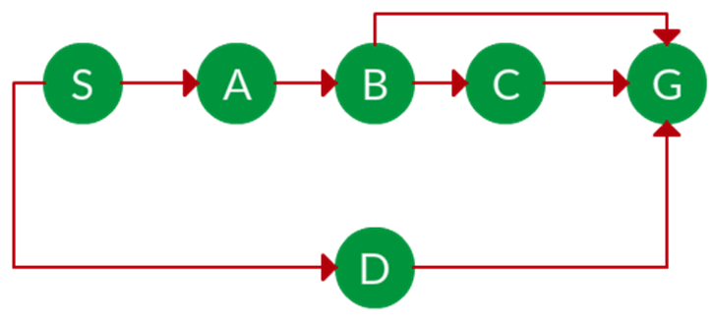
Example:
Question. Which solution would DFS find to move from node S to node G if run on the graph below?
Solution. The equivalent search tree for the above graph is as follows. As DFS traverses the tree "deepest node first", it would always pick the deeper branch until it reaches the solution (or it runs out of nodes, and goes to the next branch). The traversal is shown in blue arrows.

Slide 26
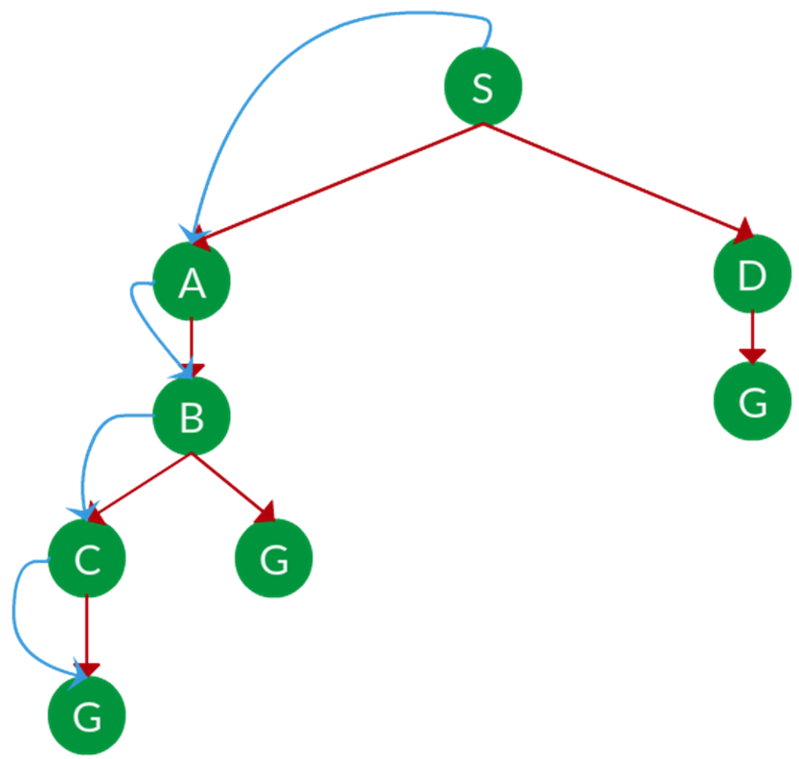
Path: S -> A -> B -> C -> G
d = the depth of the search tree = the number of levels of the search tree.
ni = number of nodes in level i i .
Time complexity: Equivalent to the number of nodes traversed in DFS. T(n)=1+n2+n3+...+nd=O(nd) T(n)=1+n2+n3+...+nd=O(nd)
Space complexity: Equivalent to how large can the fringe get. S(n)=O(n×d) S(n)=O(n×d)
Completeness: DFS is complete if the search tree is finite, meaning for a given finite search tree, DFS will come up with a solution if it exists.
Optimality: DFS is not optimal, meaning the number of steps in reaching the solution, or the cost spent in reaching it is high.

Slide 27
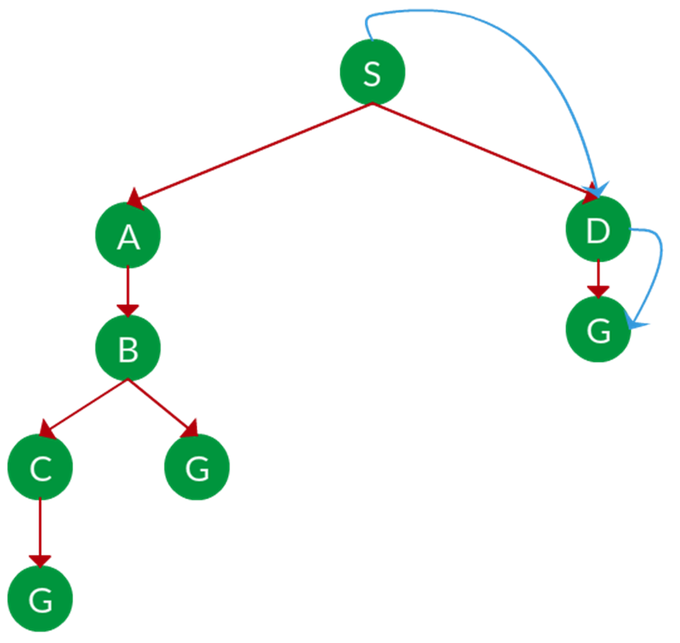
Example:
Question. Which solution would BFS find to move from node S to node G if run on the graph below?
Solution. The equivalent search tree for the above graph is as follows. As BFS traverses the tree "shallowest node first", it would always pick the shallower branch until it reaches the solution (or it runs out of nodes, and goes to the next branch). The traversal is shown in blue arrows.
Path: S -> D -> G
s s = the depth of the shallowest solution.
ni ni = number of nodes in level i i .
Time complexity: Equivalent to the number of nodes traversed in BFS until the shallowest solution. T(n)=1+n2+n3+...+ns=O(ns) T(n)=1+n2+n3+...+ns=O(ns)
Space complexity: Equivalent to how large can the fringe get. S(n)=O(ns) S(n)=O(ns)
Completeness: BFS is complete, meaning for a given search tree, BFS will come up with a solution if it exists.
Optimality: BFS is optimal as long as the costs of all edges are equal.

Slide 28
UCS is different from BFS and DFS because here the costs come into play. In other words, traversing via different edges might not have the same cost. The goal is to find a path where the cumulative sum of costs is the least.
Uniform Cost Search (UCS) Algorithm
• Use Priority Queue
• Sorted increasing order of path cost
• Guaranteed to find optimal solution.
• UCS expands node with least path cost g(n) so far
When all steps are equal, breadth-first search is optimal because it always expands the shallowest unexpanded node. By a simple extension, we can find an algorithm that is optimal with any step-cost function. Instead of expanding the shallowest node, uniform-cost search expands the node n with the lowest path cost g(n). This is done by storing the frontier as a priority queue ordered by g.

Slide 29
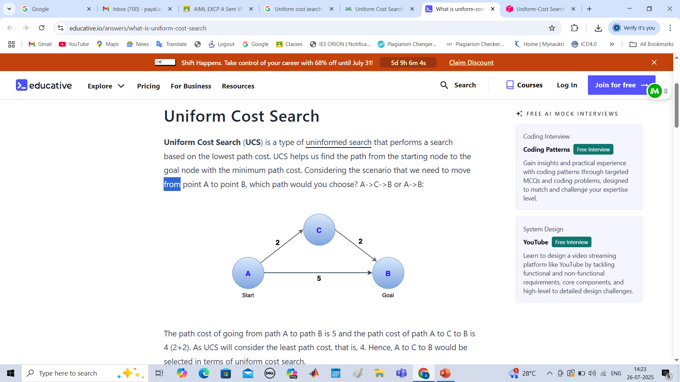
Uniform Cost Search
Uniform Cost Search (UCS) is a type of uninformed search that performs a search based on the lowest path cost. UCS helps us find the path from the starting node to the goal node with the minimum path cost. Considering the scenario that we need to move from point A to point B, which path would you choose? A->C->B or A->B:
The path cost of going from path A to path B is 5 and the path cost of path A to C to B is 4 (2+2). As UCS will consider the least path cost, that is, 4. Hence, A to C to B would be selected in terms of uniform cost search.

Slide 30
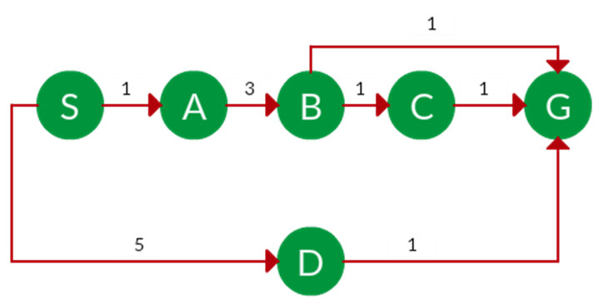
Cost of a node is defined as:
cost(node) = cumulative cost of all nodes from root
cost(root) = 0
Example:
Question. Which solution would UCS find to move from node S to node G if run on the graph below?
Example:
Question. Which solution would UCS find to move from node S to node G if run on the graph below?
Solution. The equivalent search tree for the above graph is as follows. The cost of each node is the cumulative cost of reaching that node from the root. Based on the UCS strategy, the path with the least cumulative cost is chosen. Note that due to the many options in the fringe, the algorithm explores most of them so long as their cost is low, and discards them when a lower-cost path is found; these discarded traversals are not shown below. The actual traversal is shown in blue.

Slide 31
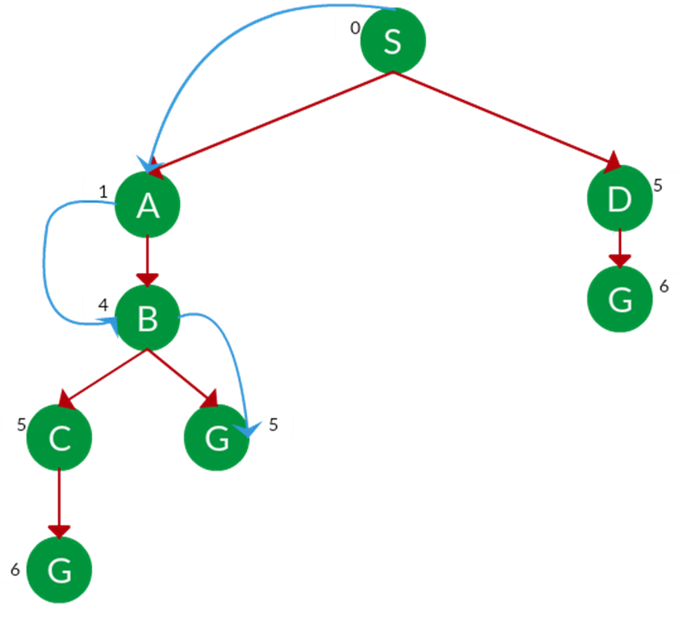
Path: S -> A -> B -> G
Cost: 5
Let C = cost of solution.
ε = arcs cost.
Then C/ε= C/ε= effective depth
Time complexity: [Tex]T(n) = O(n^C ^/ ^\varepsilon) [/Tex], Space complexity: [Tex]S(n) = O(n^C ^/ ^\varepsilon) [/Tex]
Advantages:
• UCS is complete only if states are finite and there should be no loop with zero weight.
• UCS is optimal only if there is no negative cost.
Disadvantages:
• Explores options in every "direction".
• No information on goal location.

Slide 32
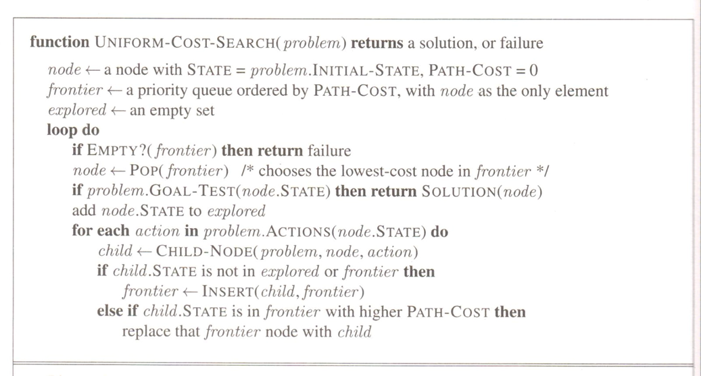

Slide 33
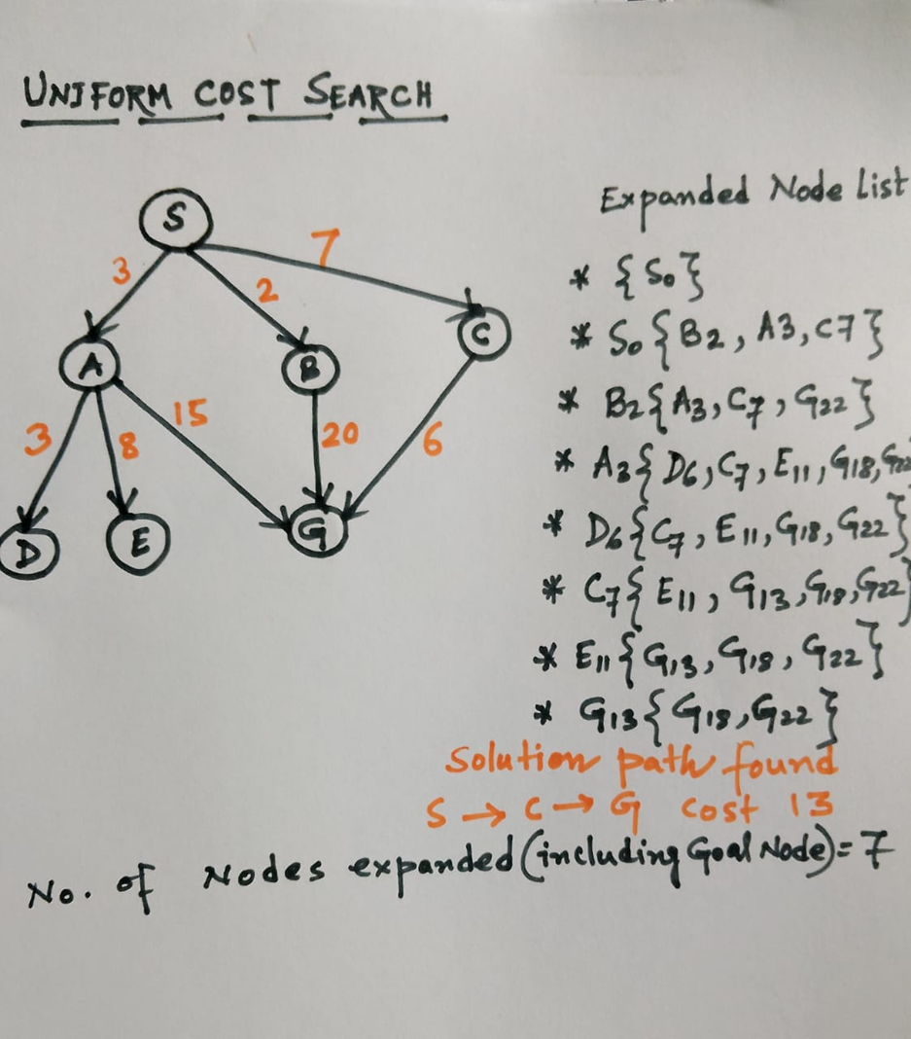

Slide 34
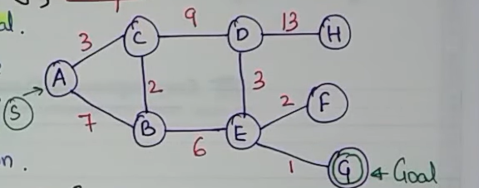
Solve the following example using Uniform Cost Search

Slide 35
Informed (Heuristic Search)
Heuristic: estimate of cost from current state to goal
Improves efficiency over uninformed methods
Heuristic Function
A heuristic is a function h(n) that estimates the cost to reach the goal from node n.
It must be:
Admissible: Never overestimates the true cost.
Consistent (Monotonic): For all nodes n and successors n', h(n) ≤ cost(n, n') + h(n').

Slide 36
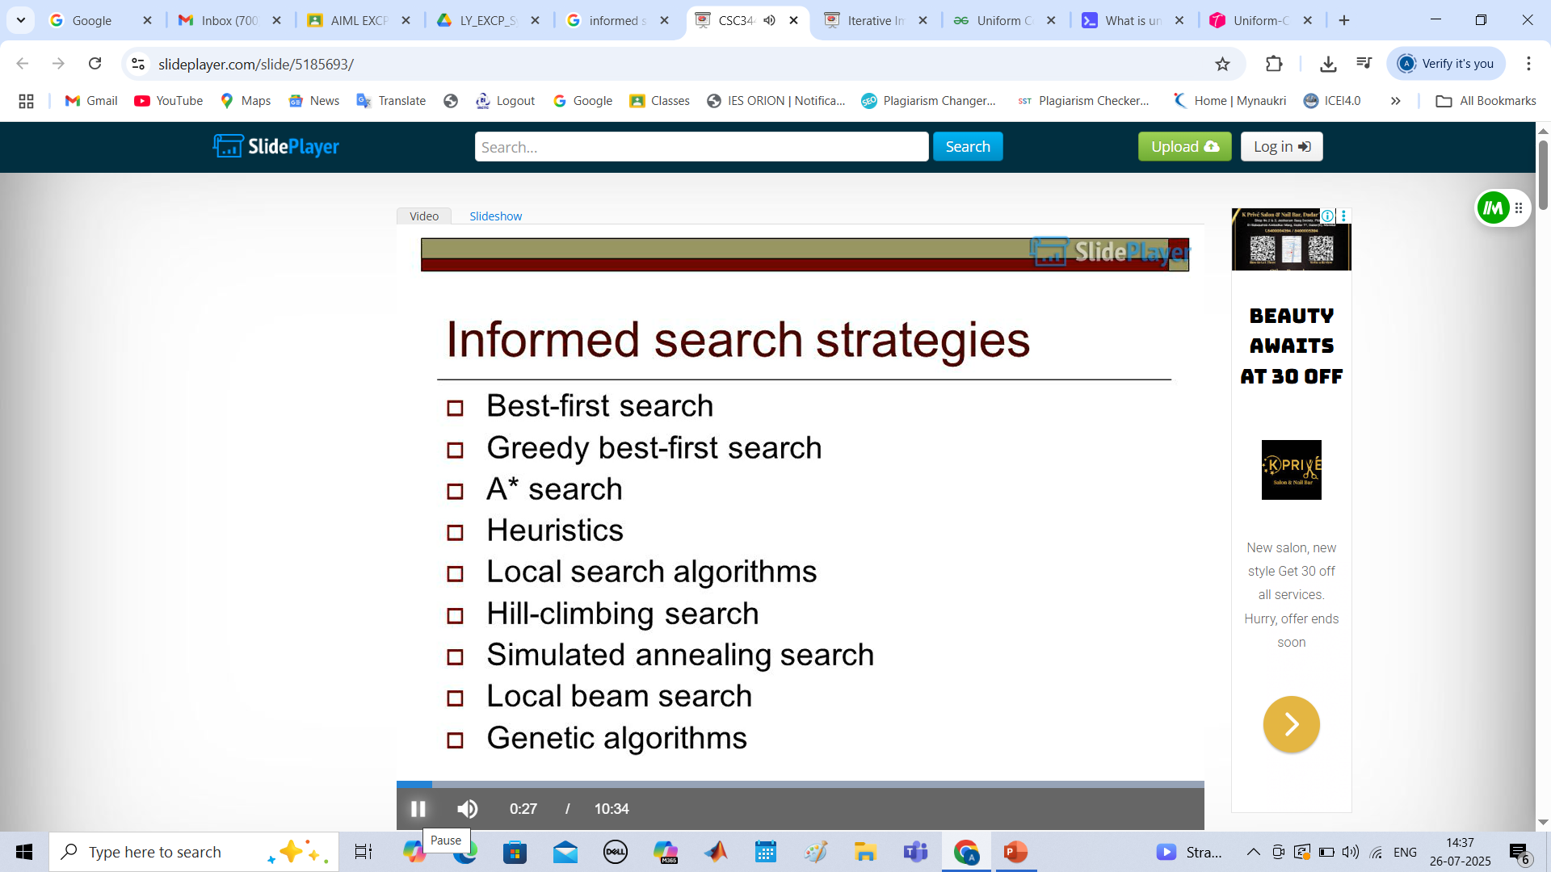

Slide 38
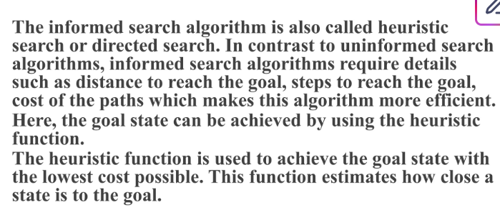
Informed Search Algorithms

Slide 39
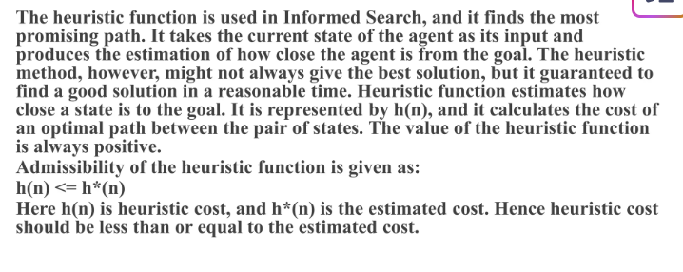
Heuristic Function

Slide 40
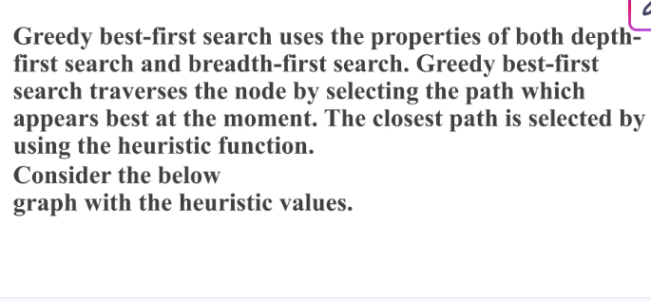
Greedy Best First Search

Slide 41
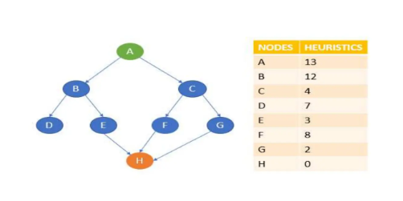
Greedy Best First Search

Slide 42
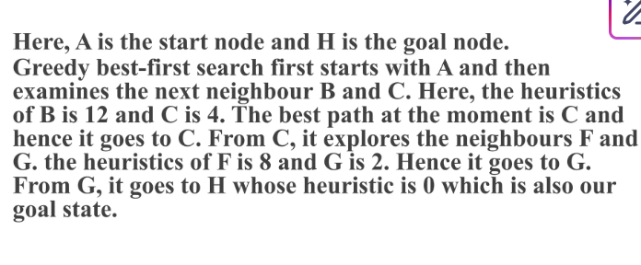
Greedy Best First Search

Slide 43
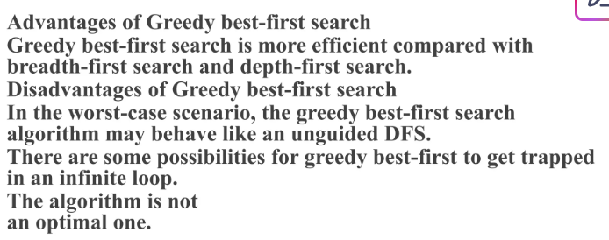
Advantages of Greedy Best First Search

Slide 44
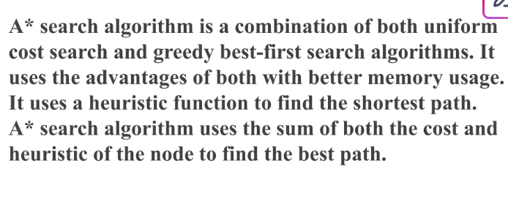
A* Search Algorithm

Slide 45
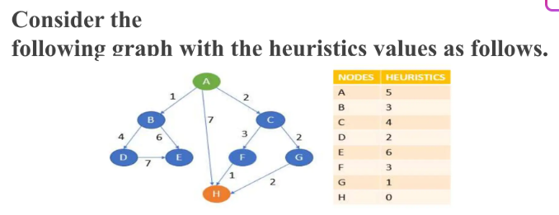
A* Search Algorithm Example
Formula
f(n) = g(n) + h(n)
Make a table: Node, g(n), h(n),f(n),parent node
Where:
f(n):
The total estimated cost of the path from the start node to the goal node, passing through node n. This is the value used to prioritize which node to explore next.
g(n):
The actual cost incurred to reach node n from the start node. This represents the "past cost."
h(n):
The estimated cost (heuristic) to reach the goal node from node n. This represents the "future cost" and must be an admissible heuristic, meaning it never overestimates the true cost to the goal.

Slide 46
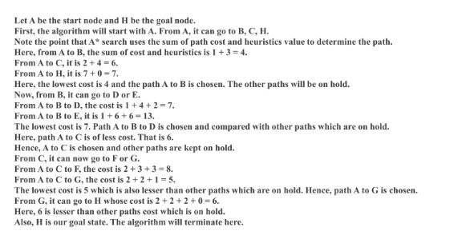
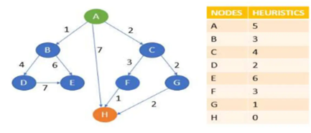
A* Search Algorithm Example

Slide 48
Best-First Search
Selects node with lowest heuristic value h(n)
Greedy strategy: picks seemingly best path
Not always optimal

Slide 49
A* Search
Combines path cost and heuristic: f(n) = g(n) + h(n)
Optimal if h(n) is admissible (never overestimates)
Widely used in GPS, robotics, games

Slide 50
Example – A* vs. Greedy Search
Diagram showing pathfinding on a graph
Highlight different choices made by each

Slide 51
Heuristics
Admissible: Never overestimates
Consistent: h(n) ≤ c(n, n') + h(n')
Good heuristics reduce search time dramatically

Slide 52
Search Problem Example: 8-Puzzle
Initial State: Random arrangement of tiles
Goal State: Tiles ordered from 1 to 8, blank at the end
State Space: All possible tile configurations (9! states)
Successor Function: Move blank tile up/down/left/right
Path Cost: Number of moves

Slide 53
BFS Example: 8-Puzzle
Explores all nodes level by level
Finds shortest path but uses a lot of memory
Not practical for deep puzzles (memory explosion)

Slide 54
DFS Example: 8-Puzzle
Follows one path deep before backtracking
Memory efficient but may get stuck in loops
Not guaranteed to find shortest solution

Slide 55
UCS Example: Route Finding
Start: Arad, Goal: Bucharest
Path cost = distance
UCS expands cities based on total path cost
Guaranteed to find shortest path

Slide 56
A* Example: Route Finding
Start: Arad, Goal: Bucharest
f(n) = g(n) + h(n) where h(n) = straight-line distance to Bucharest
A* finds optimal path efficiently if h(n) is admissible

Slide 57
Heuristic Example: 8-Puzzle
h1: Number of misplaced tiles
h2: Sum of Manhattan distances (more accurate)
A* with h2 generally performs better than with h1

Slide 58
Summary
Search is key to AI problem-solving
Choose the right algorithm based on:
Problem size and structure, Time and space constraints, Availability of heuristics

Slide 59
Questions / Discussion

